Slide 1

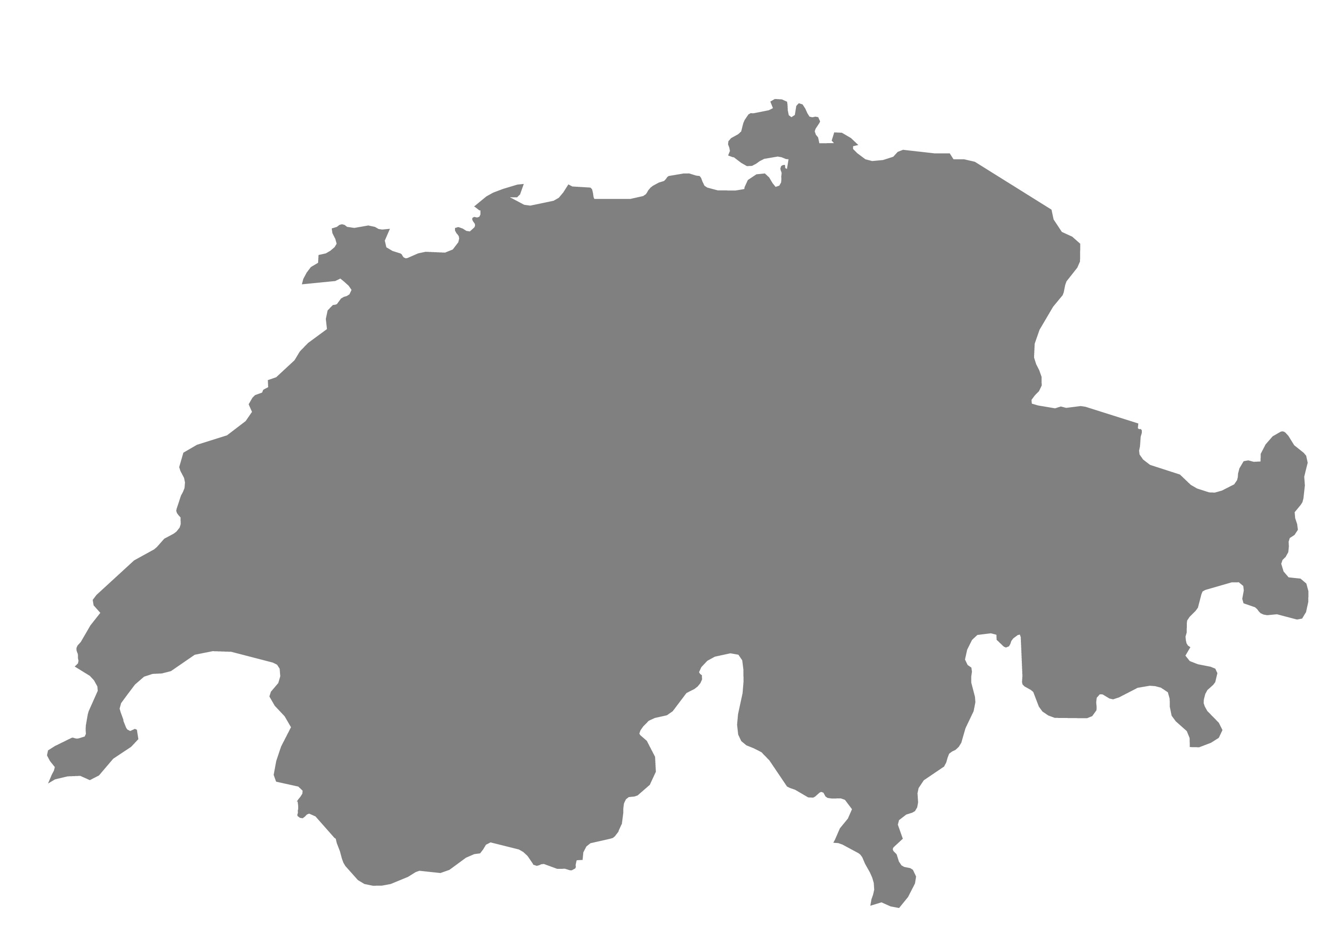



The Battle of Neighborhoods
Best Location for Bookstores near Swiss Universities
Prepared by Kristina Bokareva
January 2021

Slide 2
Agenda
Introduction
Data Acquisition and Clean-Up
Methodology
Results
Discussion
Conclusion

Slide 3

Introduction
dfSwiss Universities – top ranked worldwide
Aim – find business opportunies for bookstores near Swiss Universities, if there are any
Not just Swiss students, also international
Examine venues near Swiss Universities
dfLocations near universities can be opportunistic for businesses
Students need books and stationaries
Bookstores could have opportunities

Slide 4
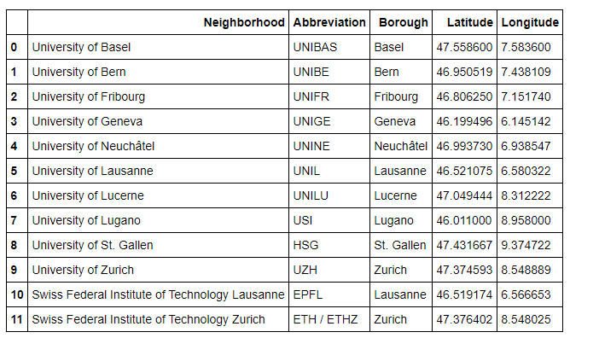
Data Acquisition and Clean-Up
What do we need ?
List of Swiss Universities
Geographical Coordinates of Swiss Universities
How do we get it?
Add columns that you need: «Latitude» and «Longitude»,and paste geographical coordinates
Decide what columns you need, clean-up what you don’t need
Scrape Wikipedia Page

Slide 5
Methodology
Foursquare API
Firstly, a function is created and run that extracts the categories of venues near Swiss Universities in the radius of 500 meters.
Dataframe “venues” is created.
Count
The number of venues in each neighbourhood is counted.
The number of unique categories is calculated. It accounted for 125 unique categories.
Venue Analysis
It is done with one hot encoding as well as by grouping rows by university and by taking the mean of frequency of occurrence of each category.
Dataframe “book” is created, which shows the occurrence of bookstores near Swiss Universities.
25 most common venues near Swiss Universities are examined.

Slide 6
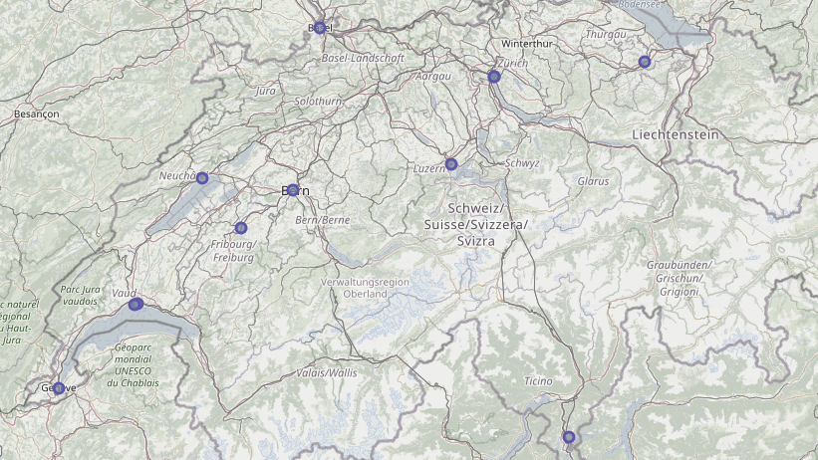
Results
Only 3 universities out of 12 have bookstores at their proximity.
They are in the Western part of Switzerland.
Bookstores are not the most popular venues.
Only for the "University of Fribourg" it is one of the 25 most common venues.

Slide 7
Discussion
Observations:
There are not many bookstores near Swiss Universities.
Bookstores are not the most popular venues for students.
Bookstores that are located near Swiss Universities, are in the Western part of Switzerland.
The most popular venues for students are the ones which are related to food and drinks.
Assumptions:
Digitalization → No need for physical books and stationaries
Culture makes a difference (Western part of Switzerland is mostly French speaking)
Recommendations:
Open a bookstore in the Western part of Switzerland, near such universities as University of Neuchâtel, University of Lausanne, or Swiss Federal Institute of Technology Lausanne.
Reconsider a business model – open bookstore/coffee shop

Slide 8

Coclusion
Aim – met
Analysis – conducted
Important! Limitations:
Only Swiss Universities were considered. There are other educational institutions in Switzerland, as business schools, colleges, etc.
Project is based on observations and personal assumptions. It does not include any scientific background and literature.

